Slide 1

Makerspace Raspberry PI
Workshop 1: The basics

Slide 2

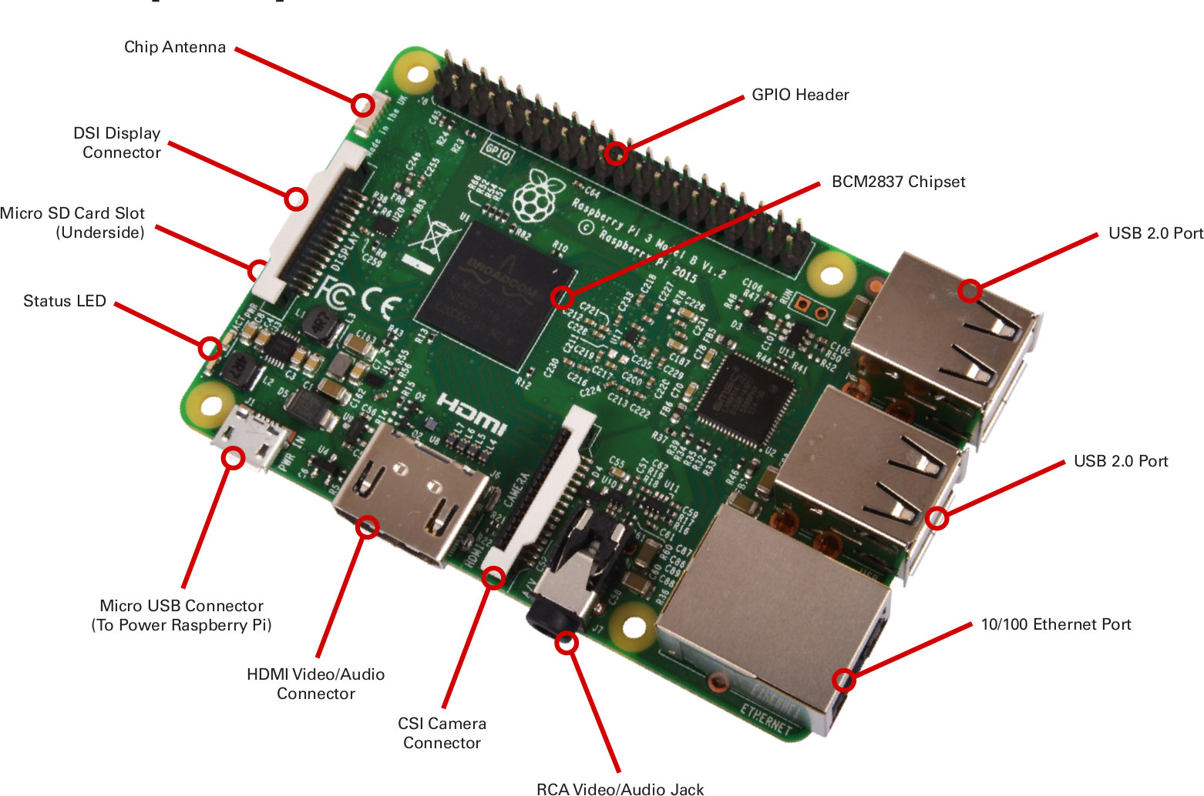
What is the PI (3B)?
Single Board Computer
Inexpensive – $30
Runs Linux (Raspbian / Ubuntu)
Quad core 1.2 GHZ SoC, 1GB RAM

Slide 3
What can you make with a pi?
Autonomous Robots and Drones
Security Camera
Retro Gaming Console
and much more!

Slide 4
Differences from Arduino
Orders of magnitude faster CPU
01
High speed IO (Ethernet, Wireless, USB, HDMI, CSI, etc)
02
Can be programmed with a multitude of programming languages
03
Command Line Interface (Shell)
04

Slide 5
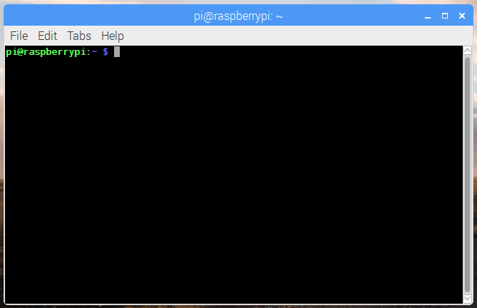
Command Line
For many tasks on the Pi, it is necessary to know your way around command line
CASE SENSITIVE!

Slide 6
REMOTE Login to the PI Over SSH
Windows Users:
https://www.chiark.greenend.org.uk/~sgtatham/putty/latest.html
Hostname: 172.25.131.14
Linux & Mac Users:
ssh username@172.25.131.14
Username: <TBD>
Password: <TBD>

Slide 7
Navigation
pwd – Print the current working directory, or what folder the shell is in
ls – List the current directory contents (show what is in the folder)
Try ls –lash
mkdir – Create a new directory
Try mkdir stuff
cd – Change directory (folder)
cd stuff

Slide 8
Move / Copy / Delete
mv – moves a file or directory from a source to a destination
mv source dest
cp – Copies a file or directory from a source to a destination
cp sourceFile destFile
cp –r sourceDirectory destDirectory
rm – Remove a file or directory
rm filename
rm –r directoryName

Slide 9
Session
ssh username@hostname – Login to a remote terminal over the network
exit – ends the current shell session

Slide 10
Python Programming Language Basics
Extremely easy to learn
1 line “Hello World” program
print(“Hello world!”)
2/3 lines for a complete program to read / write a GPIO
Huge amount of easily accessible libraries available to make your life easier
pip install pyserial

Slide 11
Python Lesson Files
Available at https://github.com/csvance/IEEE-pi
Run these commands:
cd ~
git clone https://github.com/csvance/IEEE-pi
Change directory to the IEEE-pi/python folder
cd ~/IEEE-pi/python

Slide 12
Hello World
python3 lesson1_hello.py
You should see “Hello, World!” printed on the screen
nano lesson1_hello.py
Arrow keys move the cursor
CTRL+X to quit (gives you a choice to save)

Slide 13
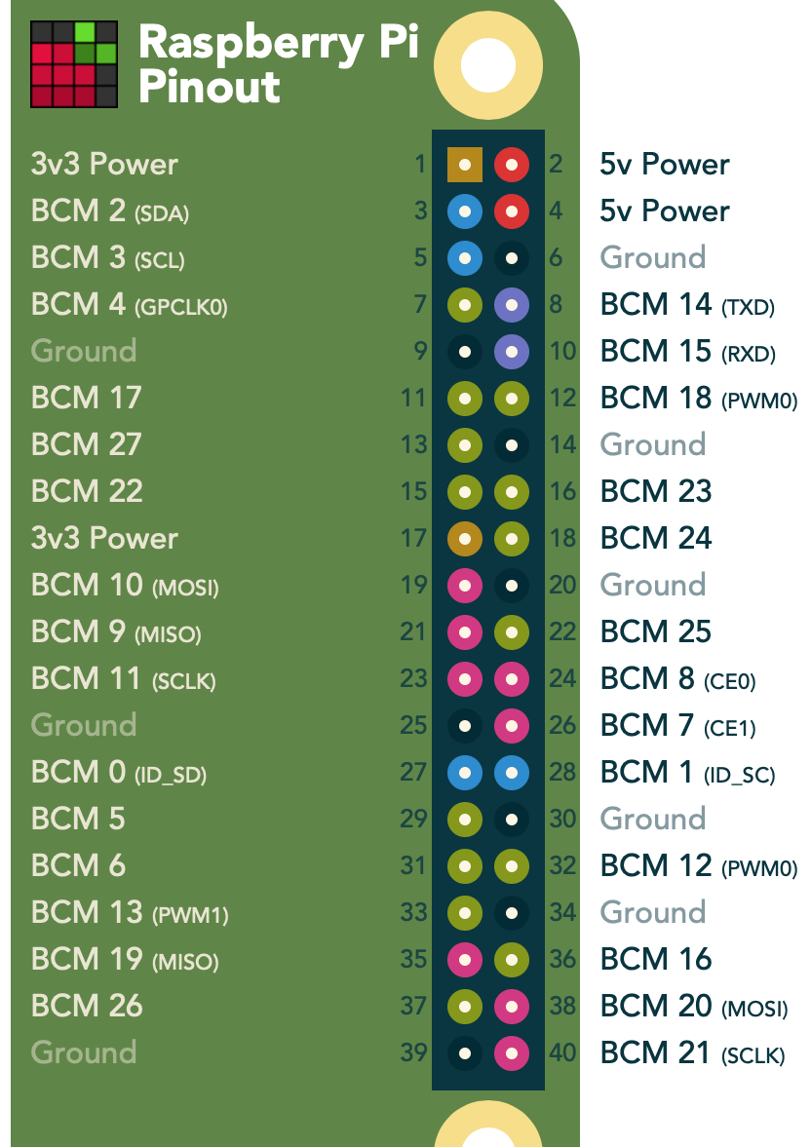
More examples: IO
GPIO, PWM, UART
Take a look at these files but don’t run them yet
lesson1_gpio.py
lesson1_pwm.py
lesson1_uart_tx.py
lesson1_uart_rx.py

Slide 14
Group TASK
Read the file “alice.txt” and send it over UART to the Raspberry Pi connected to the projector.
See the lesson1_assignment.py file for a starting point.

Slide 15
Individual TASK Mac / Linux
Download Atom text editor for editing your python code:
https://atom.io
Use rsync to sync your code to the pi
cd my_code_folder
rsync –arv . username@hostname:/home/username/
Setup public key authentication to sync without a password
https://www.linode.com/docs/security/authentication/use-public-key-authentication-with-ssh/
Install the “platform-ide-terminal” plugin for atom so you can run rsync inside your atom window

Slide 16
Individual TASK Windows
Download Atom text editor for editing your python code:
https://atom.io
Download an SFTP client to copy your code to the Pi
https://winscp.net/eng/index.php

